Slide 1
1. https://subros.com ( banner design 3 images) for homepage
2- product image with description
3- gatikooto logo
4- our mgmt detail - image name and experience
5- pdf part for ( all product detail )
6- company profile pdf
7- All address , mail-id phone number
8- Google map ( lat/long) update company name

Slide 2
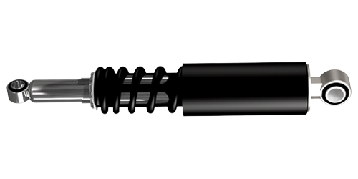
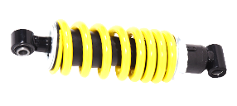
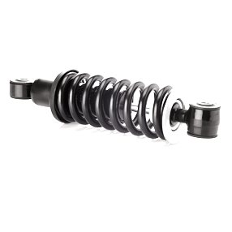
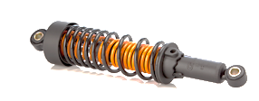
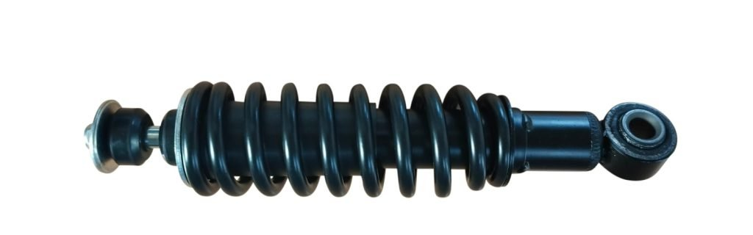
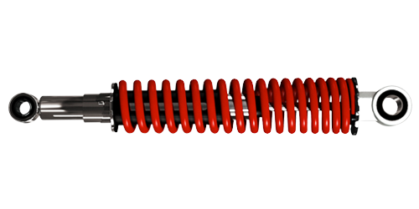
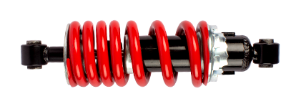

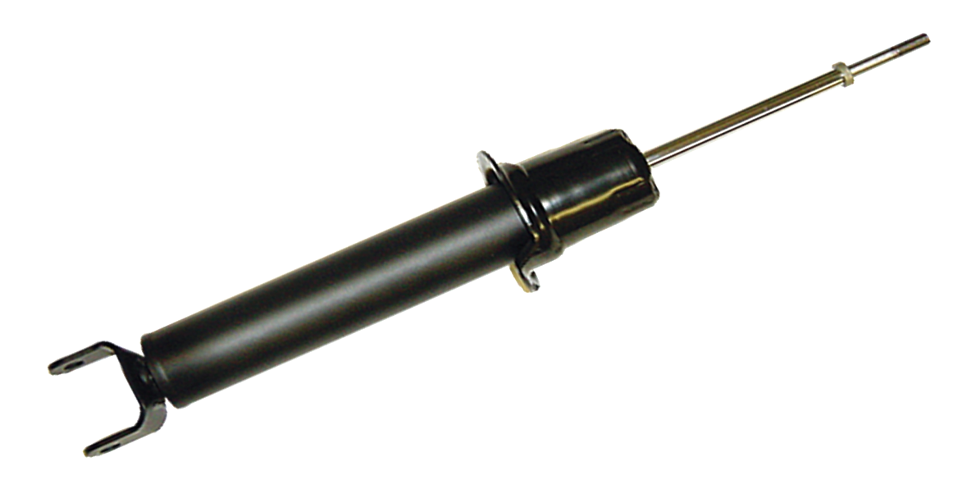
Splendor
Spring n Spring Suspension
Hydraulic Twin Tube Suspension
Strud Type 3 Wheeler Suspension
Mono Suspension
Activa Front

Slide 3
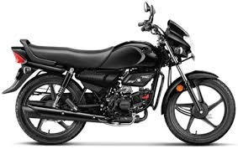
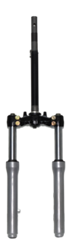

Slide 4
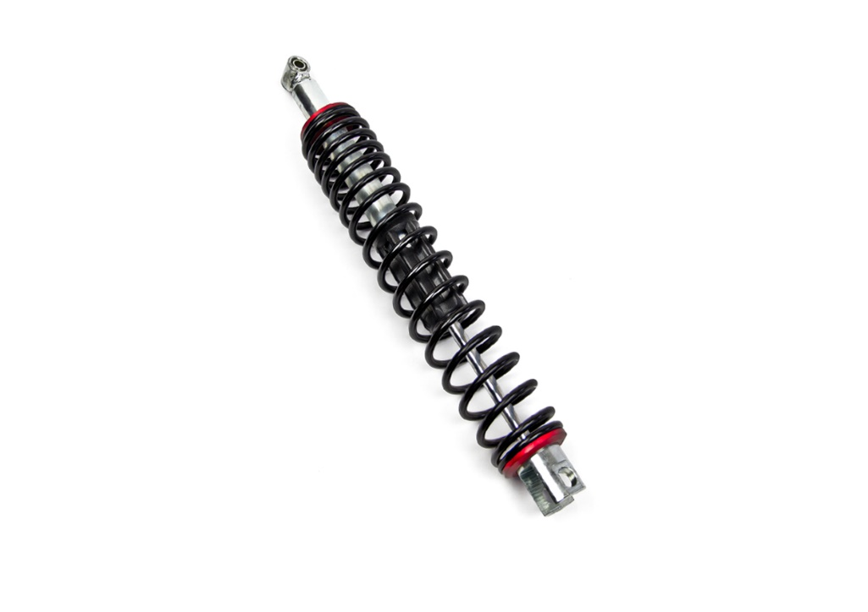
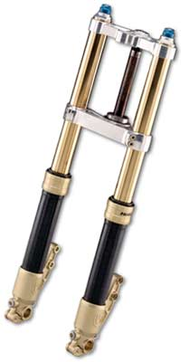
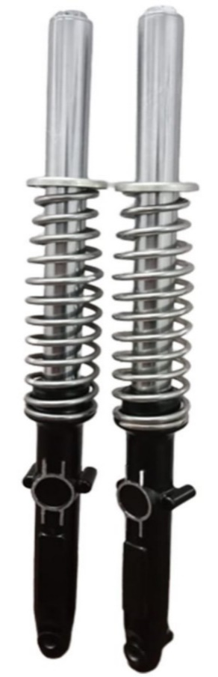

Slide 5
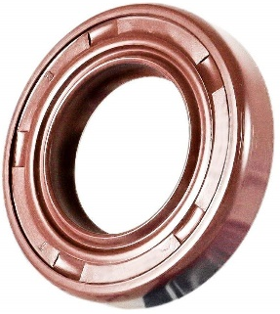
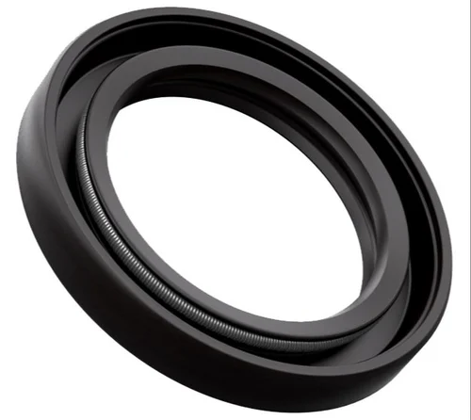

Slide 6
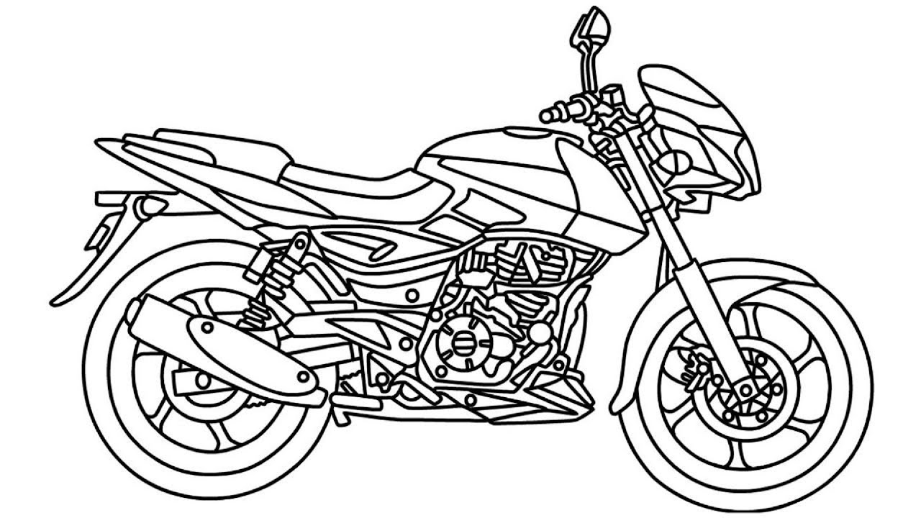

Slide 7

GATIK LOGO

Slide 8
VIPIN KUMAR
KAMAL SINGH
Graduate Engineer from BITS
Having Two Decade of Experience in Engineering
over one decade in suspension
Looking After Operations & Engineering
Versatile Mechanical Engineer with Hands on Experience in Precision Machining
Having Two Decade of Experience
Looking After Commercial
SATISH SINGH
VINEET ASTHANA
Veteran Marketing Professional in Engineering Parts Hands on Experience in Product Promotion & launch
Looking after Business development , Brand Promotion Global After Market
Energetic Marketing Professional from Engineering Background
Hands on Experience in OEM Marketing & Brand Promotion
Looking after Business development , Brand Promotion Global OEM Market

